Slide 1
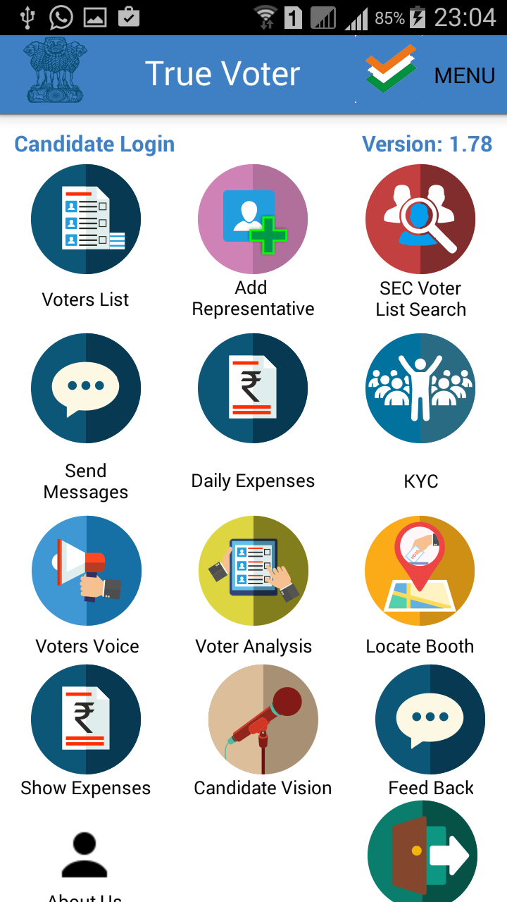
True Voter version 1.78
Daily Expenses Module :
This function is used to submit details of daily expenses in the election to the government.
To use daily expense function user should be logged in as a Candidate with his registered mobile no.
Representative can also use this function.
For this president or ward member have to add representative under his number.
Click on ‘Daily Expenses’ function.

Slide 2
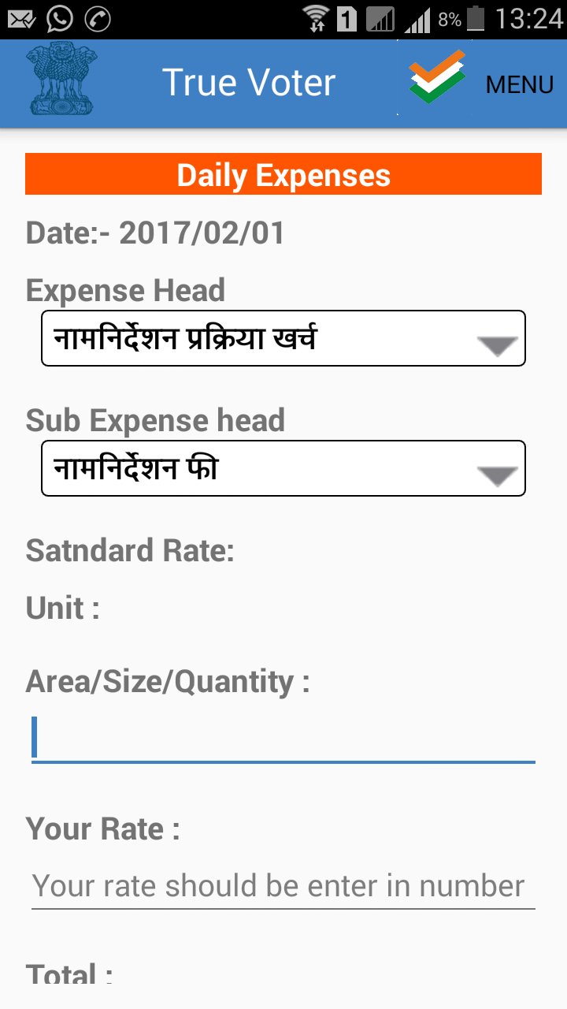
True Voter version 1.78
Daily expense page will be displayed to the user.
Daily expenses are supposed to be added every day date wise and print out is supposed to be submitted every day to election officer.
Expense heads and sub heads are to be downloaded first and
To download standard rates click on ‘Menu’ option.
You can add expenses of those head and sub heads of which standard rates are provided. You can not add the entry of such sub head whose standard rate is not given.
As per the selection of Head and sub head provide its quantity/area/Size/Nos used by you.
Already Standard rate is given of that sub head, you provide your actual rate u paid for that selected sub head

Slide 3
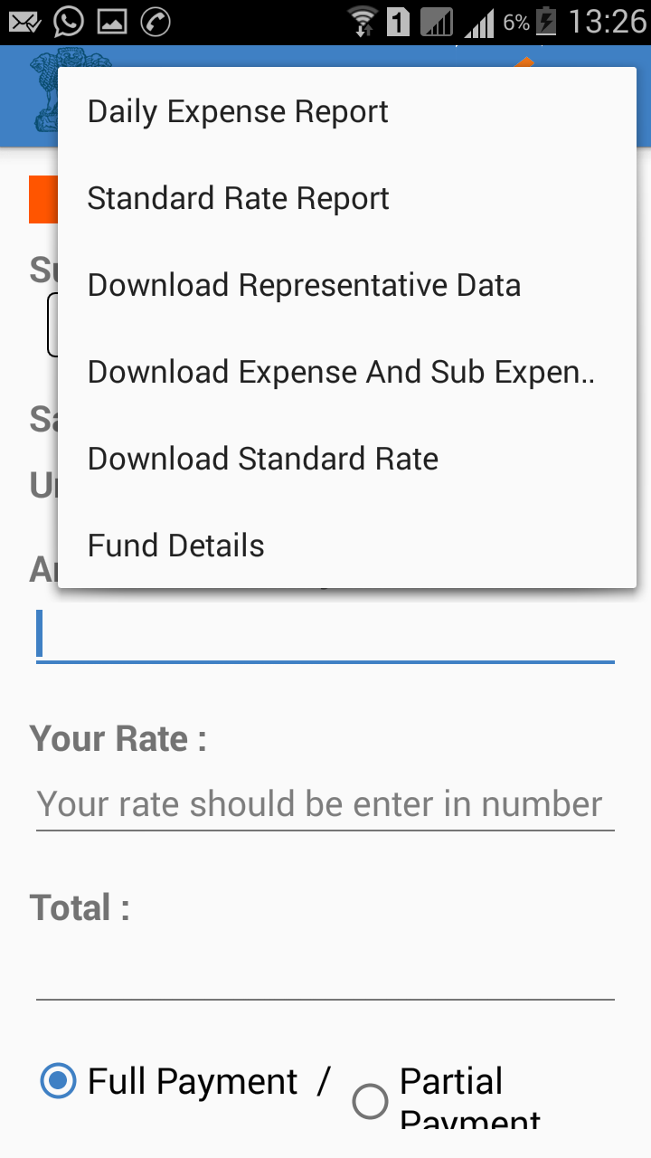
True Voter version 1.78
Click on ‘Download Expense and Sub Expense’ to download Expense head and sub expense heads entered by collector officer. Or by Municipal Commissioner office for corporation.
Please wait for minute to get download Expense and sub expense heads.
Then Click on ‘Download Standard Rate’ option from the given options.
Standard rates entered by ‘Collector officer or collector staff’ will get downloaded here. In case of corporation, rate entered by Municipal Commissioner Staff will get downloaded
Please wait for minute to get download Standard rates.
To see the downloaded Standard rates and Expense and sub expense heads use the menu “Standard Rate Report”

Slide 4
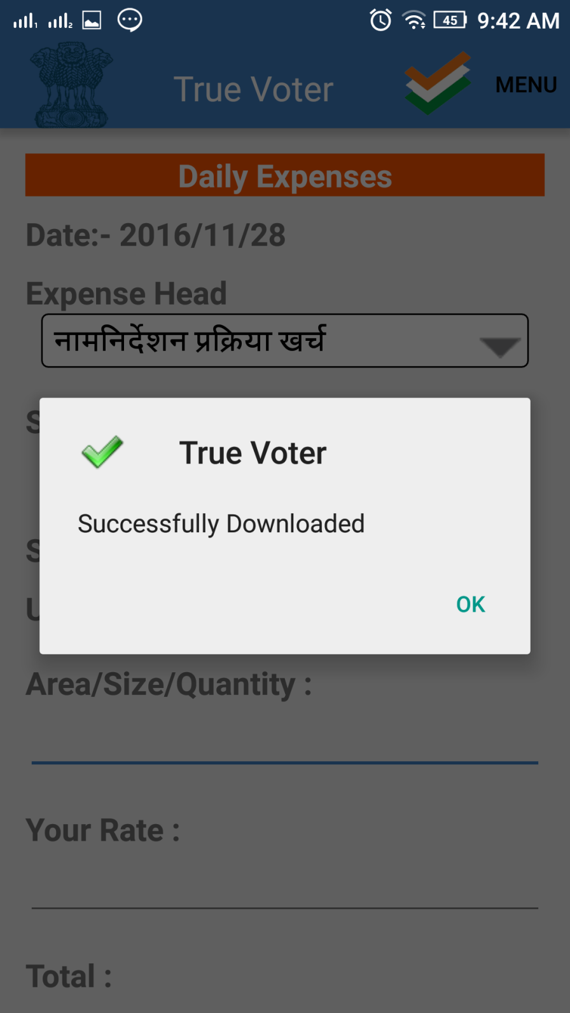
True Voter version 1.78
Candidate will get massage that ‘Successfully Downloaded”, when Expense heads and sub expense heads are getting download successfully.
User will get massage that ‘Successfully Downloaded”, when standard rates are getting download successfully.

Slide 5
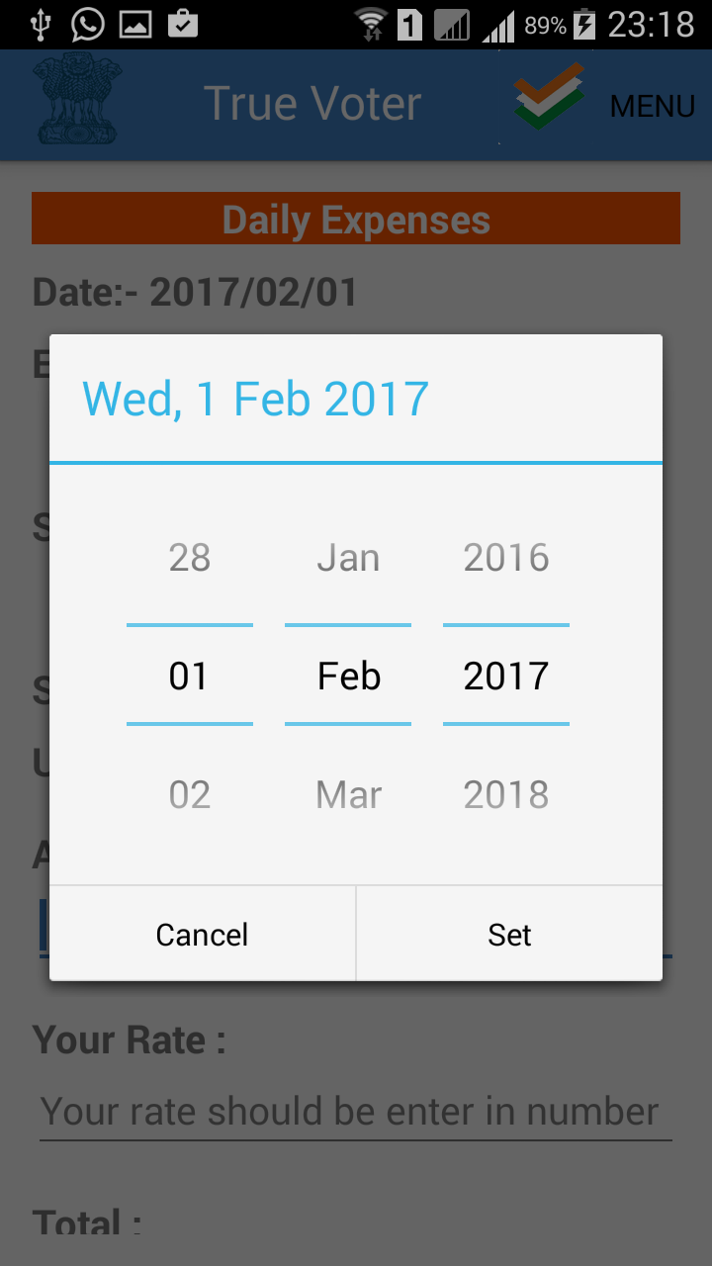
True Voter version 1.78
On the Daily expense page click on ‘Date’ to select date for which you want to enter daily expenses.
Select date of which you have to add entry and click on ‘SET’.

Slide 6
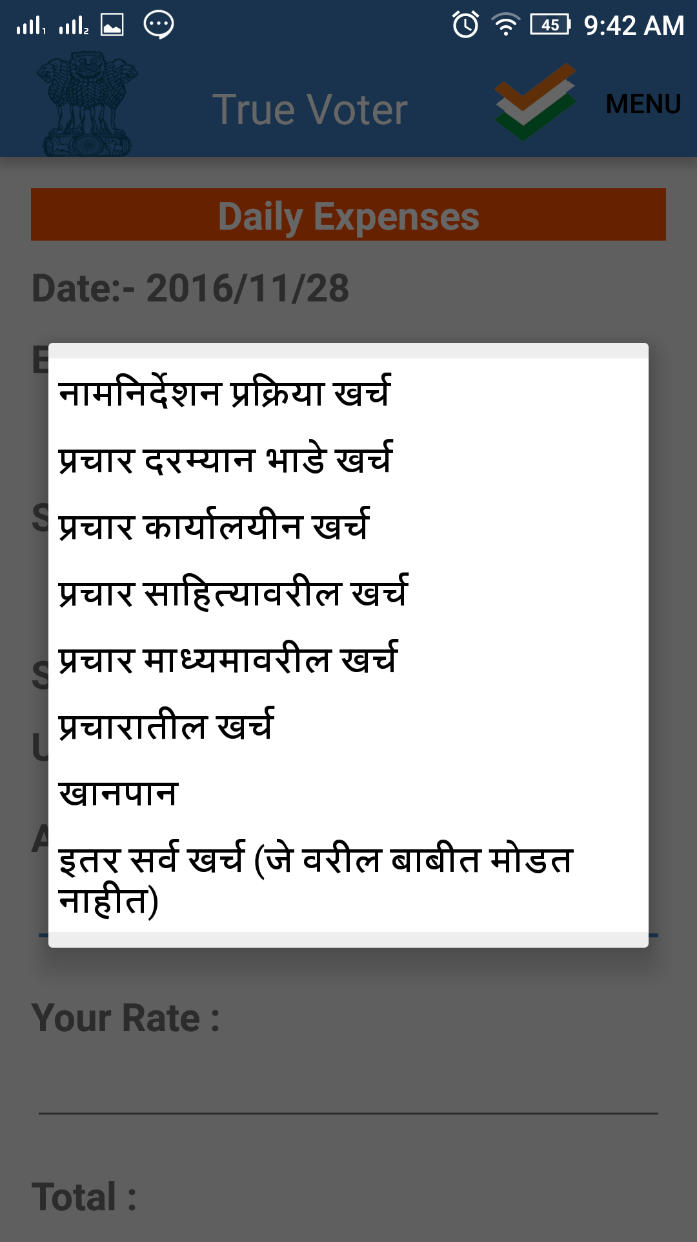
True Voter version 1.78
Click on ‘Expense Head’.
Select expense head from the given list.
There are total 8 main expense heads.
Each main head have multiple sub heads.

Slide 7
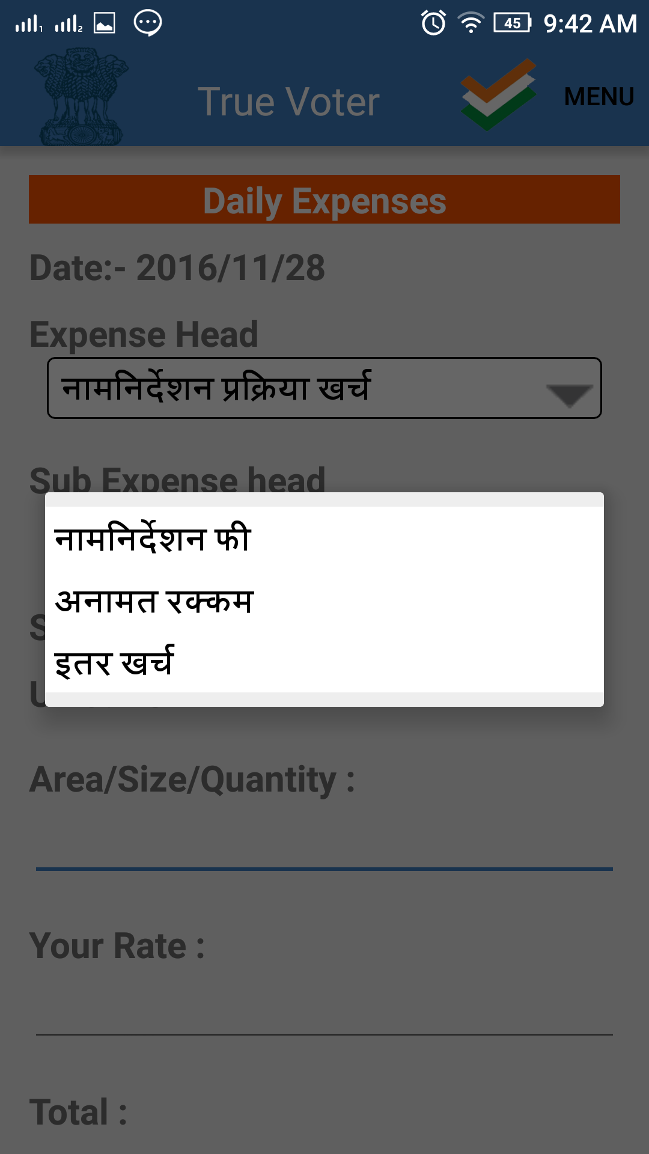
True Voter version 1.78
Click on ‘sub expense head’.
Select ‘sub expense head from the given list.
Any no of multiple entries of same Head and Sub Expense Head can be added as required.

Slide 8
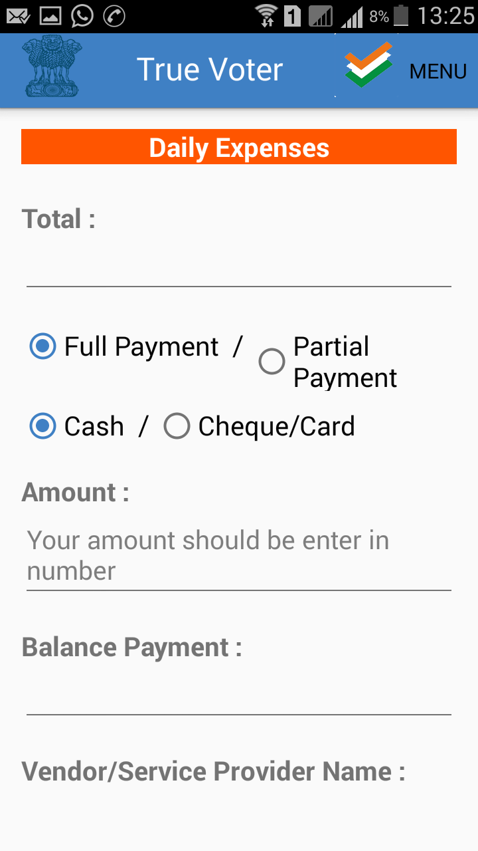
True Voter version 1.78
As per your entered quantity and rate, Total amount of the selected item is displayed below “Total “.
Select the option whether you have paid the bill full or partially. Select the option whether you have paid the bill cash or by cheque.
Amount actually is not too much. If you are paying partial then “Total” and “Amount” will be different. Enter Amount paid, Balance payment to be paid latter will also be displayed in “Balance Payment”.
U have to enter the vendor name, his mobile no, if the entry is related to any government then provide the landline no if it is not available then provide “9999999999” it indicate that the office don’t have even landline no.

Slide 9
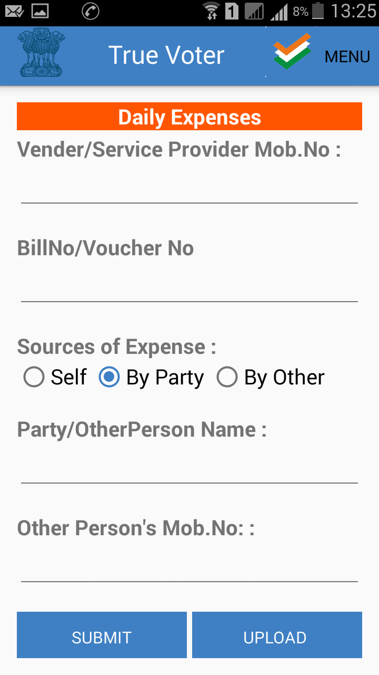
True Voter version 1.78
Provide the Bill no of the entry. If you can’t get Bill no then provide your self created voucher no for that payment.
If you had paid your self then use “Self” option or if this is done by party for you then use “By Party” option. If the expenses are done by any friend or relative for you then “By Other” is to be used. Provide that friend name and mobile no.
Press “Submit” button to save the entry.
To see your added entries use “Daily Expense Report” from upper “MENU”
U can update entry if require. From “Daily Expense Report” touch the entry which u want to modify, it will appear on main screen again, correct it and press “Update” button.
At last Press “Upload” to upload entry to server. Entry once uploaded can’t be changed.

Slide 10
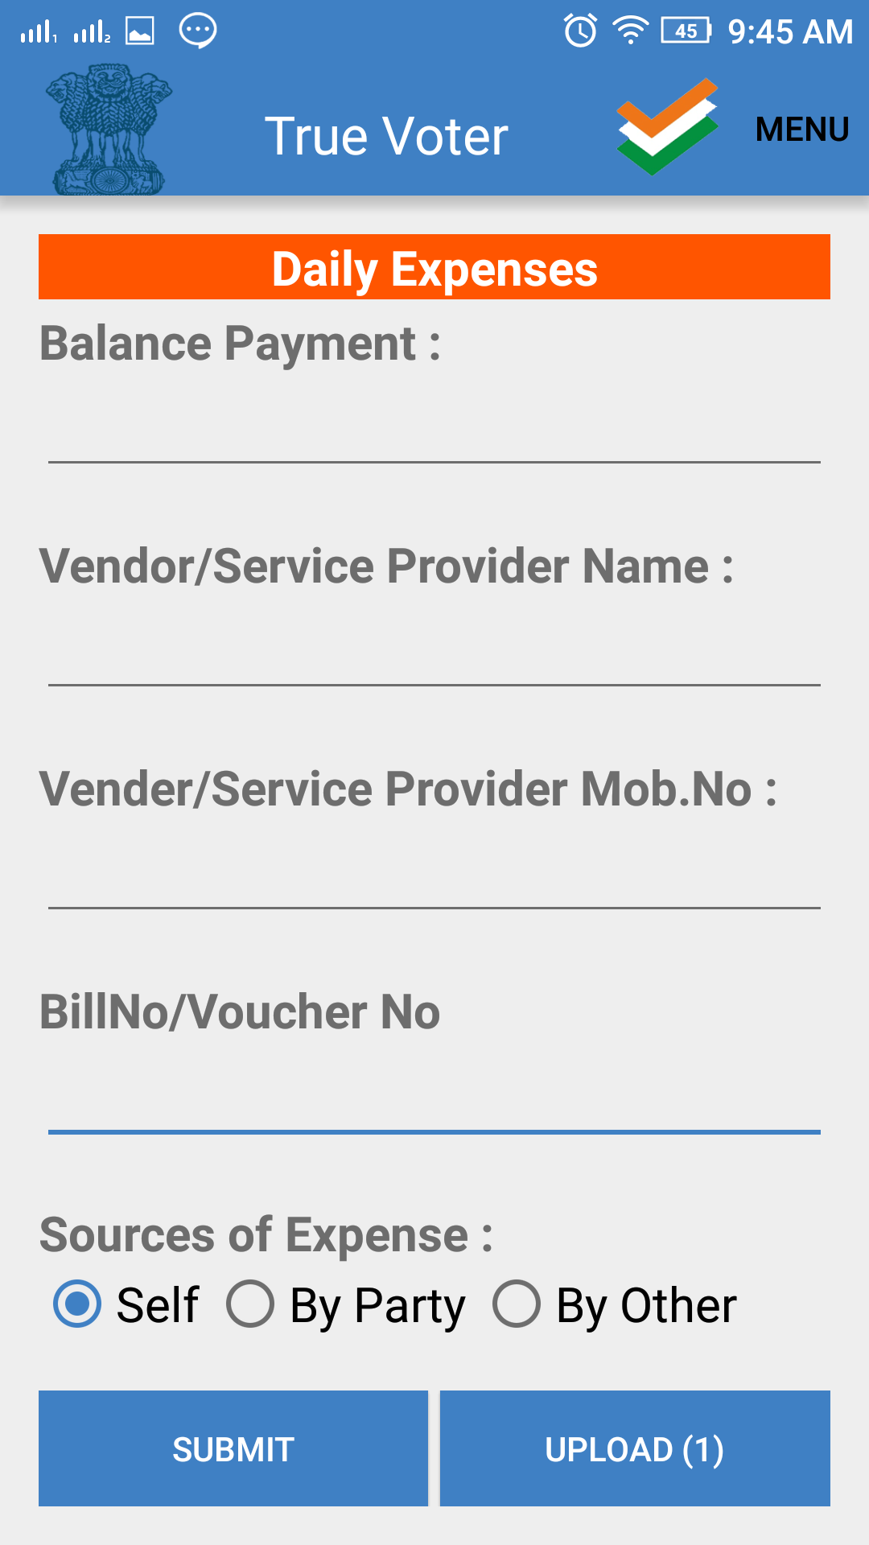
True Voter version 1.78
After submit data upload counter will be increased.
To view report for the submitted data click on ‘Menu’ option on the upper right corner of the screen.

Slide 11
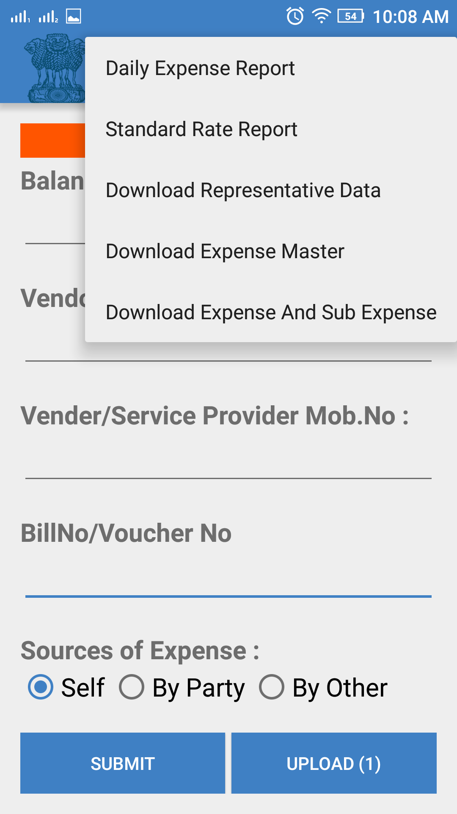
True Voter version 1.78
Select ‘Daily Expense Report’ option.
User will be displayed the report on the next page.

Slide 12
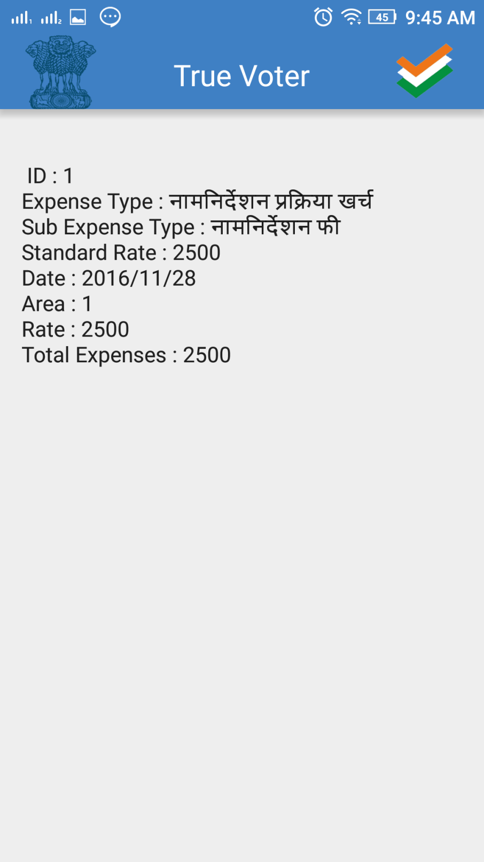
True Voter version 1.78
Report for Daily expense will be displayed as shown in the screen shot.
Click on the record to update.
The selected entry for update will be displayed to user.
Make changes if any change and then click on ‘Update’ button to update record.
To view the updated entry go to ‘Menu’ and select ‘Daily Expense Report’.

Slide 13
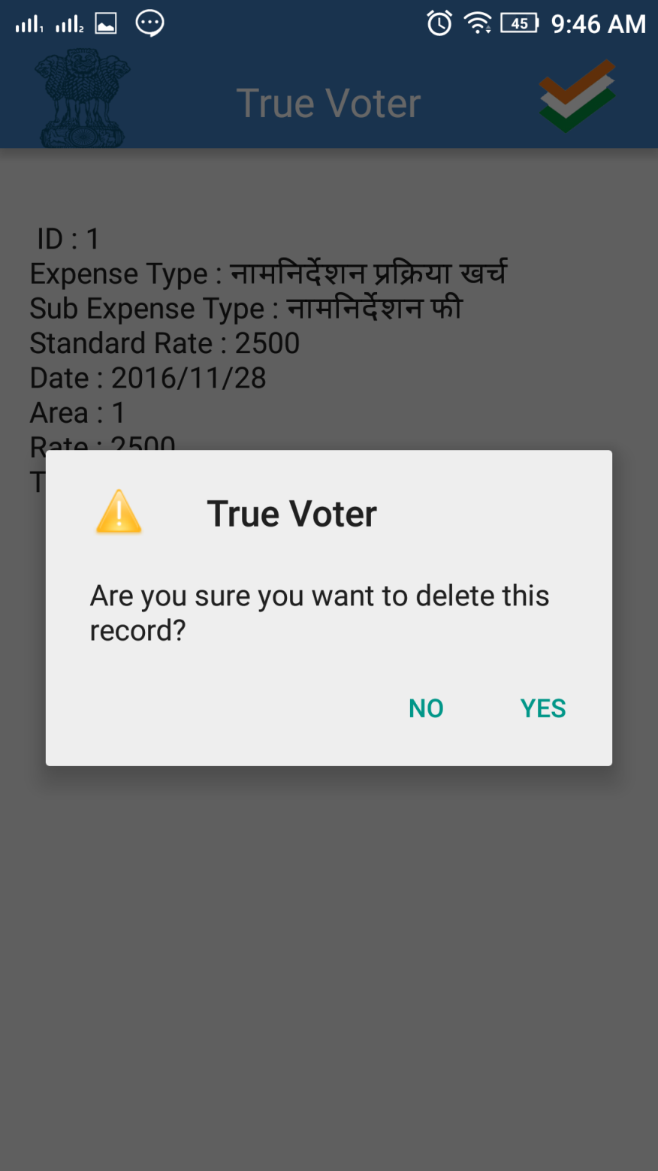
True Voter version 1.78
If user wants to delete submitted ‘Entry’.
On the ‘Daily Expense Report’ page click and hold the entry which user wants to delete.
Click on ‘yes’ to confirm delete record
Note – user can update and delete record before uploading record.
Once record get upload then user can not make changes in the record.

Slide 14
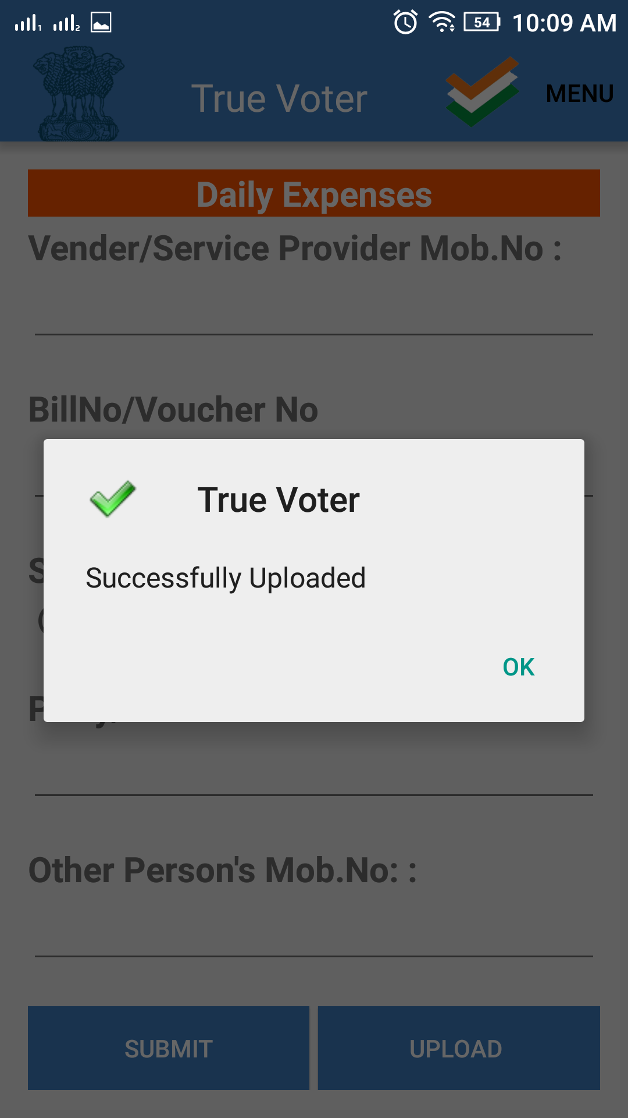
True Voter version 1.78
After uploading data user will get message as ‘Successfully upload’.
Press “OK” to continue.
Add further entries and follow the same process as seen till now.

